Slide 1
Score and Diffusion Models
Week 5

Slide 2
Variational Models
Last week: variational models
Typically: use strong priors over the latent variable distribution:
Low rank
Simple parametric form
Limitations:
Blury results - high-frequency (fine) details are often not low-rank
The parametric choice of p(z) might be too restrictive

Slide 3
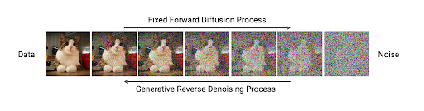
Diffusion Processes
Variational models: link between p(x) and latent distribution p(z)
No known correspondences
Diffusion models: add noise to each x until it becomes noise
Noise added through time
Small amount of noise at every time step

Slide 4
Reverse Diffusion Process
Goal is to reverse the diffusion process
Map the distribution of Gaussian noise p(z) to p(x)
Diffrently from VI, can do it in many, very small steps
At each stage, we only invert a tiny temporal step – not so hard
Inversion = denoising a small amount

Slide 5
Life of a Sample
Let us start from sample x at time 0
At each time step t:
Shrink to origin by factor x = x - x * f(t) (f(t) > 0)
Add random Gaussian noise x = x + g(t) W (W = N(0, I))
At time 1, sample will lose original information, contain pure noise
Notes:
בכל צעד נתון לוקחים את התמונה ומכפילים אותה בפקטור קטן מ1 (כל פיקסל, כל מימד) (בדרך כלל תלוי בזמן). לאחר מכן מוסיפים רעש גאוסיאני.
(בתרגיל אין את הצמצום, רק מוספים רעש).

Slide 6
Types of Processes
Variance preserving (VP):
Variance is unchanged through time, more is allocated to noise
Variance exploding (VE):
Variance of image is constant, while increasing amounts of noise added
Notes:
בוחרים פונקציית g(t) ואז f(t) נקבע לפי g. בצורה זו הvariance של xt נשאר 1. (צריך להיות מאותחל עם 1).
Variance exploding – רק מוסיפים רעש.

Slide 7
Stochastic Differential Equations (SDEs)
SDEs: mathematical way to describe continuous stochastic processes
Big topic, we just introduce what we need for diffusion
Let us consider our discrete time process:
x(t+dt) = x(t) - x(t) * f(t) dt + N(0, g²(t)I)
Taking step size to 0, we obtain the following SDE:
dx = - f(t) x(t) dt + g(t) dW_{t}
dW_{t} is an infinitesimal amount of Gaussian noise added at time t
E[dW_{t}] = 0
Notes:
שואלים מה יקרה לתמונה אחרי dt .
g(t) dW_{t} - הוספת רעש אינפיניטסימלי.
- f(t) x(t) dt השינוי הדטרמיניסטי לx.
g(t) dW_{t} - שינוי סטוכסטי לx.

Slide 8
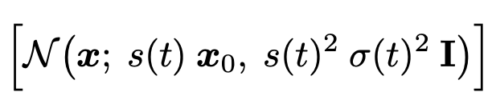
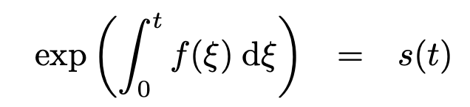
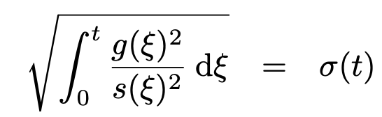
Solution of the SDE
SDE: changes to the sample at each time step
Solution of SDE: the distribution of the sample at each t
Intuitively: scaled version of the initial sample, added Gaussian noise
Will not derive it:
Distribution of sample x0 at time t
Scaling factor for mean x0 at time t
Variance of total noise at time t
Notes:
בסופו של דבר נקבל שלכל t ההתפלגות של xt (לכל פיקסל ופיקסל) היא גאוסיאנית.
הנוסחאות האלה באות לקבל את x(t) מבלי לבצע את אינסוף החישובים מהשקף הקודם.
אינטויאציה לשונות – במקרה שf(t)=0 , בכל זמן נתון מוסיפים עוד רעש גאוסיאני (ב"ת) לכן צריך לסכום את g(t) לאורף הזמן (האינסופי = אינטגרל).

Slide 9
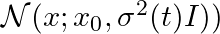
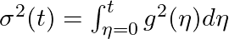
Solution of SDE in VE Process
Reminder: in VE process, scale is fixed S(t) =1 (f(t) = 0)
Inspecting previous equations:
The variance at time t, is the integral all the variances of the noises

Slide 10
Inverting the Process
So far: a noising process transforming p(x) at t=0, to p(z) at t=1
Objective: inverse process taking p(z) at t=1 to p(x) at t=0
Why not just flip the sign of the SDE?
Notes:
אי אפשר להפוך כל רעש ולהגיד שהוא הגיע מתמונה ספציפית. מנסים להגדיר תהליך שלוקח רעש ומחזיר התפלגות של תמונות. אם ניקח את כל התמונות שלקחנו מכל הרעשים, נרצה לקבל את ההתפלגות המקורית של התמונות (לא הפיכה מושלמת).

Slide 11
Inverting SDE in VE Process
Invering the VE SDE yields:
Gaussian noise is actually symmetric to sign, equation is unchanged!
Clearly not the way to invert the process…

Slide 12
The Fokker-Planck Equation
The SDE described how each sample evolves in time
How does the entire probability distribution p(x,t) evolve in time?
Solution provided by the FP equation:
This is a deterministic partial differential equation
To invert it, we simply flip the sign
Notes:
P(x,t) - ההתפלגות של כל התמונות המורעשות בזמן t.
זה חישוב ההתקדמות של ההתפלגות במיקום x בזמן t .

Slide 13
Inverting Fokker-Planck Equation
How do we achieve inversion of the sign of the FPE?
Idea: construct a deterministic process resulting in same FPE!
Named: probability flow ODE
Notes:
מה שדטרמיניסטי זה השינוי בהתפלגות, לא שינוי של כל תמונה.
היה פה מעבר מתמטי שהראה שבהגדרה הדטרמיניסטית הזאת, הגרדיאנט זהה להגדרה הסטוכסטית.
אז מה שקורה זה שזה תחליף לforward process הסטוכסטי, אז עכשין יהיה אפשר להפוך את התהליך.

Slide 14
Inverting The Noise Process
Given the probability flow ODE, reverse the process by sign inversion
Can also construct a stochastic process with the same marginals
Deterministic process called DDIM
Stochastic process classed DDPM

Slide 15
The Score Function
Remaining challenge - how to compute?
This quantity is called the score function

Slide 16
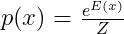
Score Does not Require Normalized PDFs
What happens is we do not know p(x), but up to normalization
For example, assume we know E(x) but not Z
Score does not depend on Z!

Slide 17
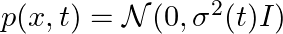
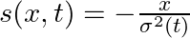
Simple Example
Assume at t=0, we have a single point
We add Gaussian noise through time s.t.
The Gaussian distribution has
The score is therefore:

Slide 18
Denoising
Task of denoising: removing noise from sample
Where D is a denoising function and n is noise

Slide 19
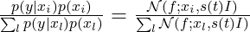
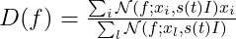
Expression for Denoising
Assume we have a noise sample f
The data consists of x samples x1,x2…xM
At time t, each x may take the values: N(xi, s(t)I)
The probability that f is in fact generated by xi is
The expected denoised value of f is threrefore

Slide 20
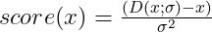
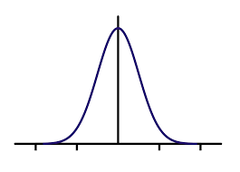
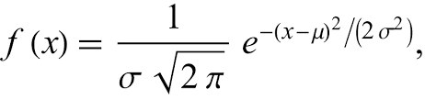
Estimating the Score
There is a simple expression for the score:
Intuition:

Slide 21
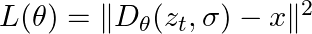
Diffusion Models in Practice - Training
First step: training denoising model
Sample: x from training distribution, random time [0,1]
Shrink and add Gaussian noise according to noising schedule – result z_{t}
Train denoising model. taking as input noisy sample, noise
Repeat until convergence

Slide 22
Diffusion Models in Practice - Sampling
Start with random noise and t=1 – define this as xt
Repeat until t=0
Denoise x_{t} using
Estimate score using
Reverse process using:
Advance time t = t - dt

Slide 23
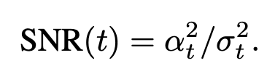
Diffusion Models in Practice – Point Estimates
The ELBO on the neg log-probability p(x) is approximately given by:
(Stated without proof)
Amazing result – probability estimation using denoising model
Time average of the denoising estimation error

Slide 24
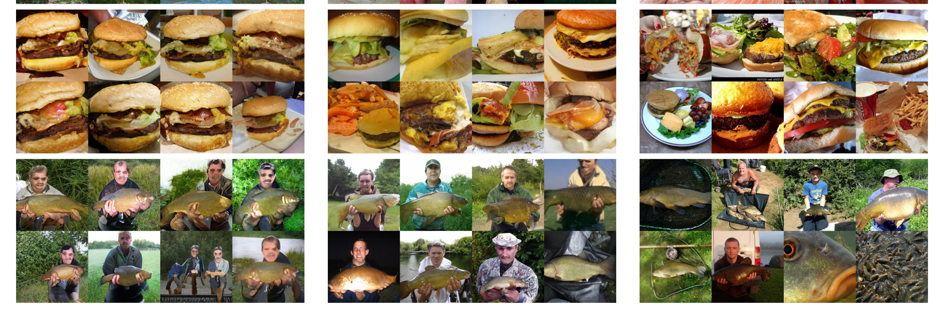
Diffusion Models: Top Image Generators
Diffusion models (center) beat GANs (left). Right – original images

Slide 25
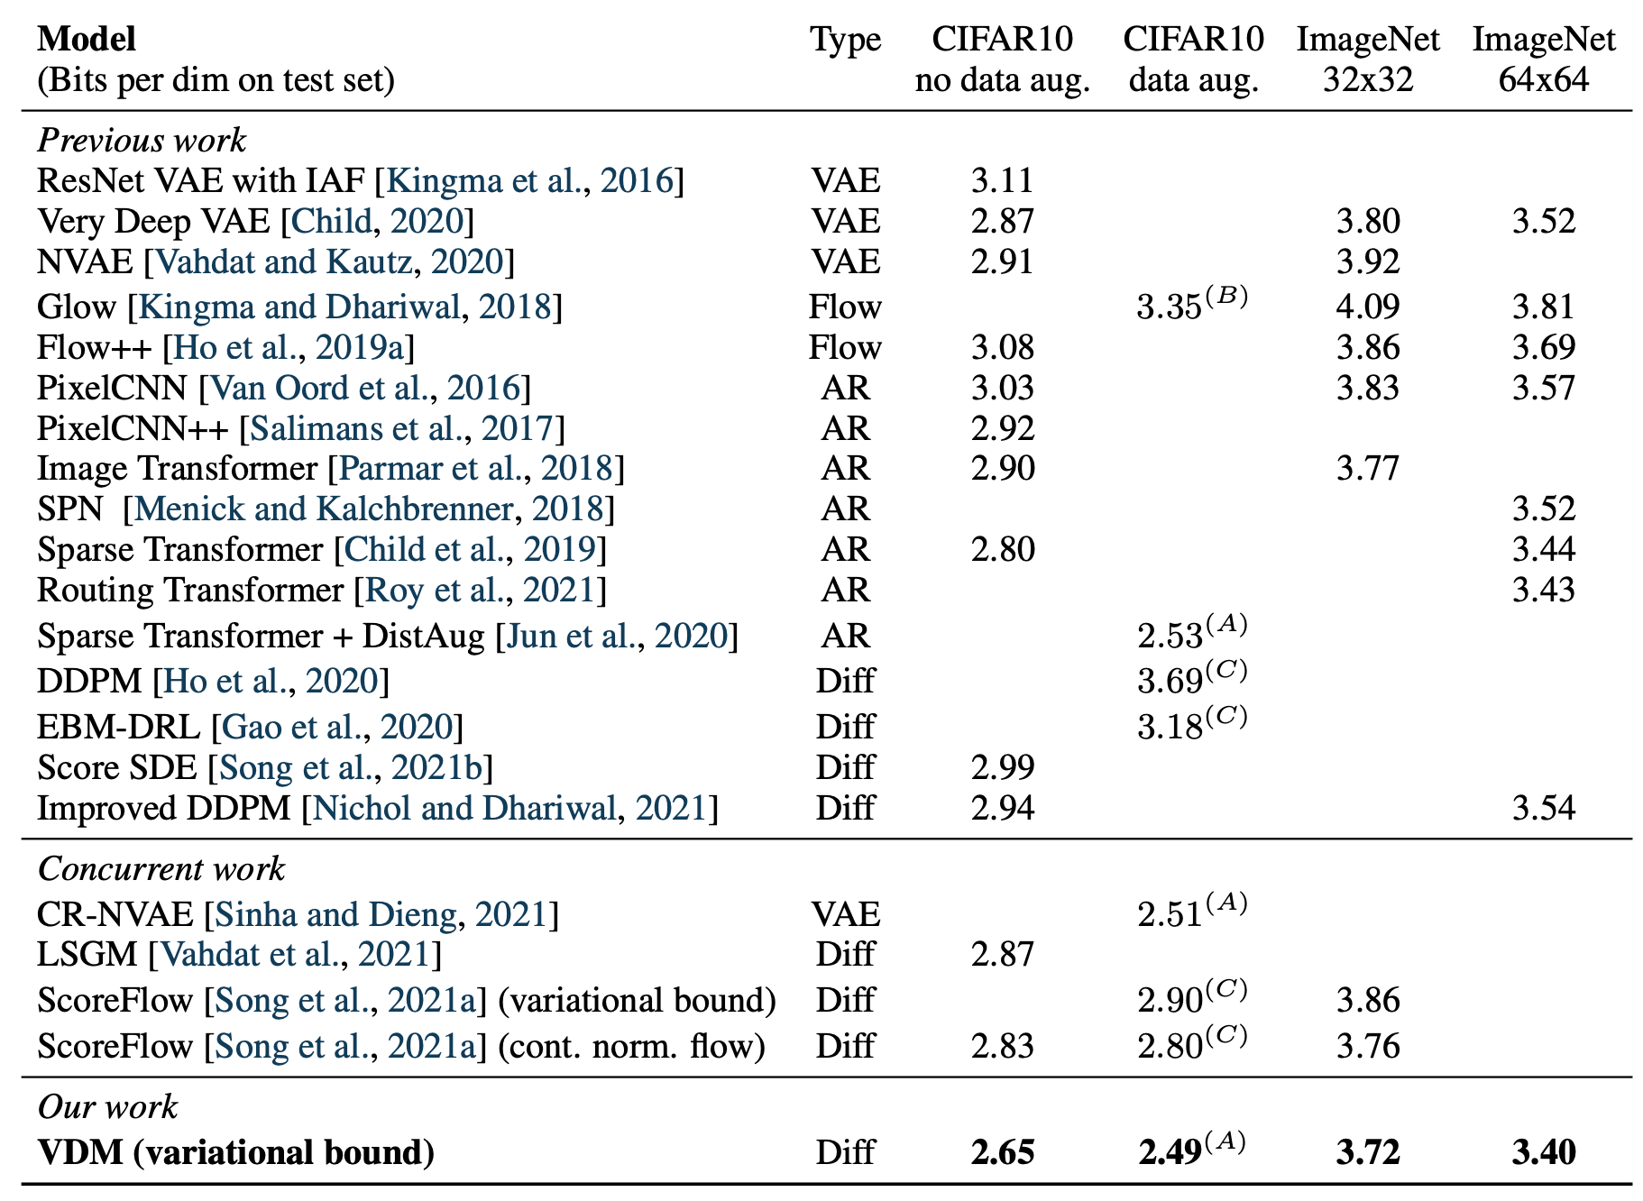
Diffusion Models: Top Likelihood Estimators
Diffusion models beat VAE and AR models at point density estimation

Slide 26
Conditional Diffusion Models
Conditional DMs: basically the same as have multiple DMs
Share the same denoiser, but condition it:
Noisy image
Time (or noise sigma)
Conditioning labels

Slide 27
Classifier-Free Guidance
Conditioning alone is often insufficient for text-guided generation
Trick (not well grounded in theory):
Denoise according to conditional and unconditional models
Use the following combination as denoising value:

Slide 28
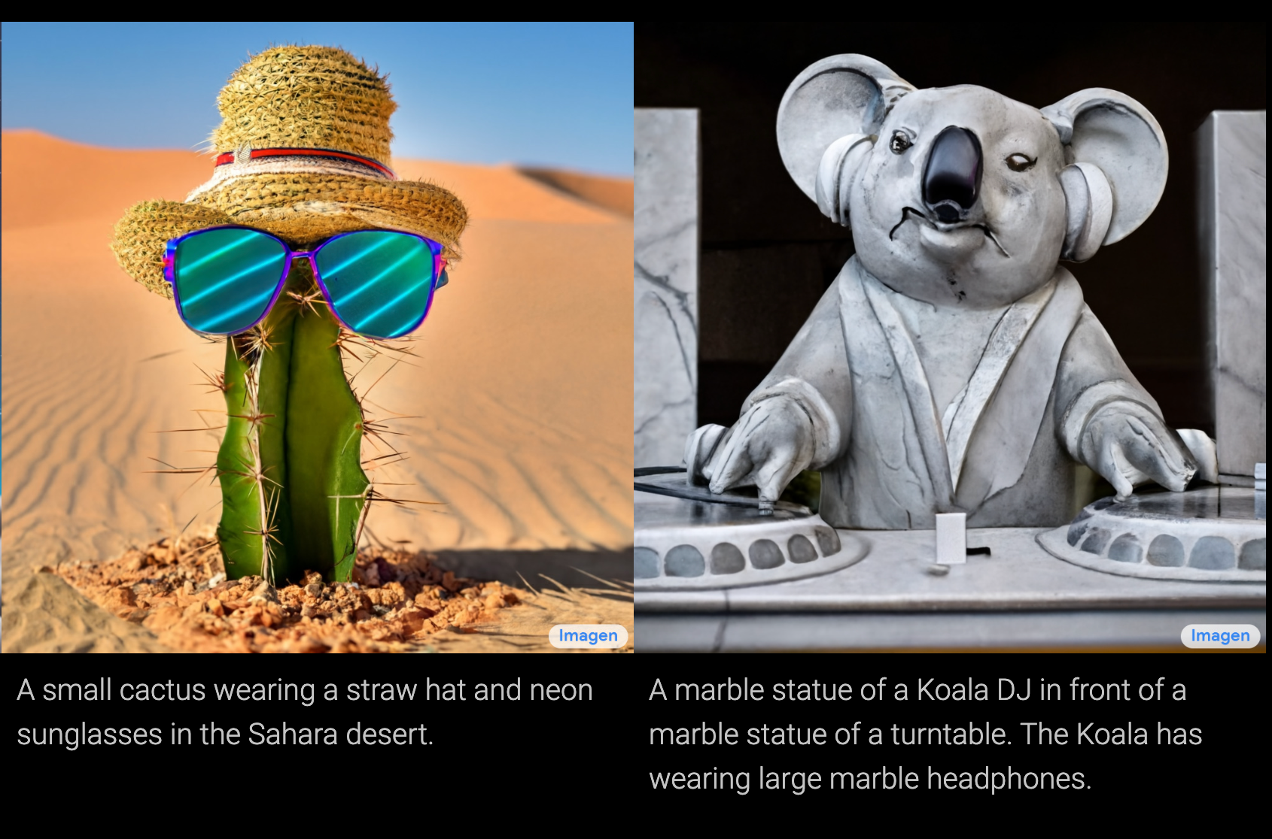
Text-to-Image Models
Dall-E 2, Imagen

Slide 29
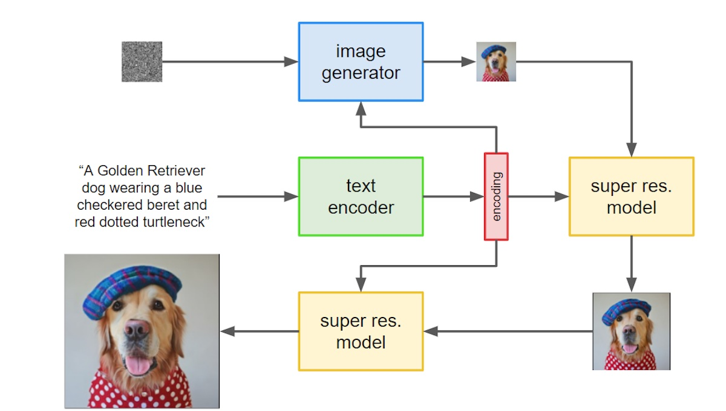
Text-to-Image Architectures
Sample Low-resolution image conditional on text
Sample high-resolution image conditional on low-res and text

Slide 30
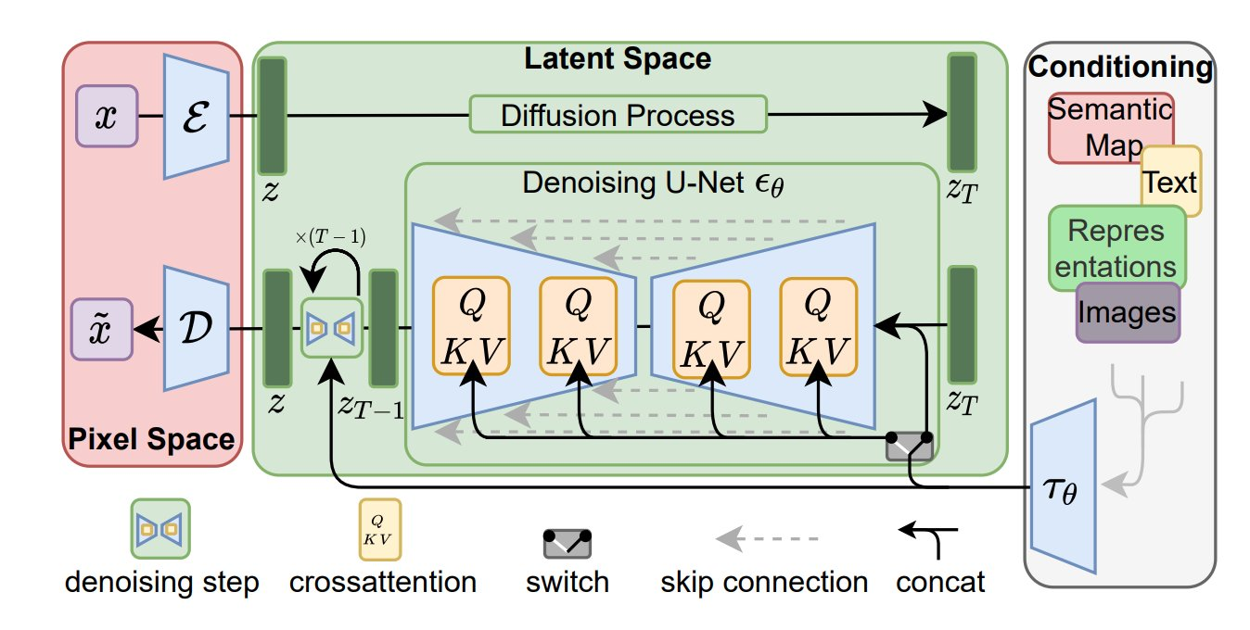
Latent Diffusion Models
Tokenizer: Train to map image to a small token grid and back
Diffusion: Perform diffusion of the low-res token grid
Dekonizer: Map synthesized token grid to high-res image

Slide 31
Imagen Video
Same as above but for video
https://imagen.research.google/video/

Slide 32
Dreamix
Train imagen-video denoiser on the video of the user
Then condition on some new text
https://dreamix-video-editing.github.io/

Slide 33
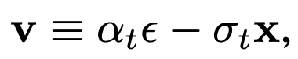
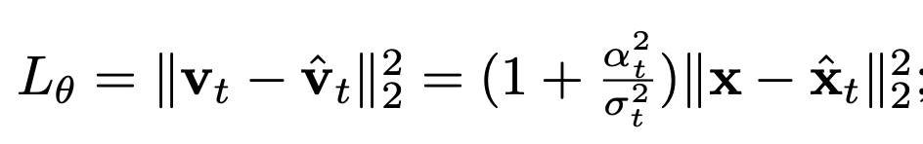
Several Prediction Targets
There are several loss functions used for the denoising models
They are equivalent up to weighting different time steps
In practice the choice makes a difference
Predict x directly (x prediction)
Predict noise direction (e prediction)
Prediction combination (v prediction)

Slide 34

MagVIT/MUSE
Instead of Gaussian noise, use binomial noise (remove pixels)
Repeat until all token complete
At each step, denoiser guesses all missing token
Most certain tokens are kept, the of predicted ones are deleted

